Slide 1
Diving into Darkness: A Comparative Analysis of Batman Movies Through NLP and Sentiment Analysis
Charity Smith
MSDS 692 Data Science Practicum
Regis Summer 2024

Slide 2
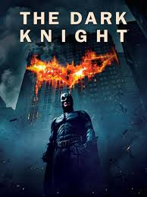
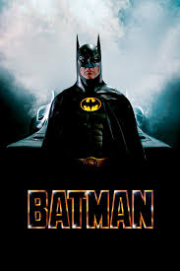
Which Batman “Wins”?
Explore the themes of darkness and the complexity of relationships in Batman movies.
Use NLP and sentiment analysis to identify the darkest version of Batman and the most subjective dialogue activity.
Analyze movie reviews to determine the most popular Batman movie.
Provide recommendations for future movie productions based on the analysis.
Batman
Screenplay by Sam Hamm
1989
The Dark Knight
Screenplay by Jonathan Nolan and Christopher Nolan
2008
Notes:
This project aims to explore the textual essence of Batman movies, focusing on the themes of darkness and the complexity of relationships between heroes and villains. Using Natural Language Processing (NLP) techniques and sentiment analysis, the project will discern which version of Batman resonates as the darkest and which exhibits the most intricate dynamics between hero and villain. Additionally, it will analyze movie reviews to determine the most popular Batman movie. The ultimate goal is to shed light on the power dynamics within the Batman universe and provide recommendations for future movie productions.

Slide 3
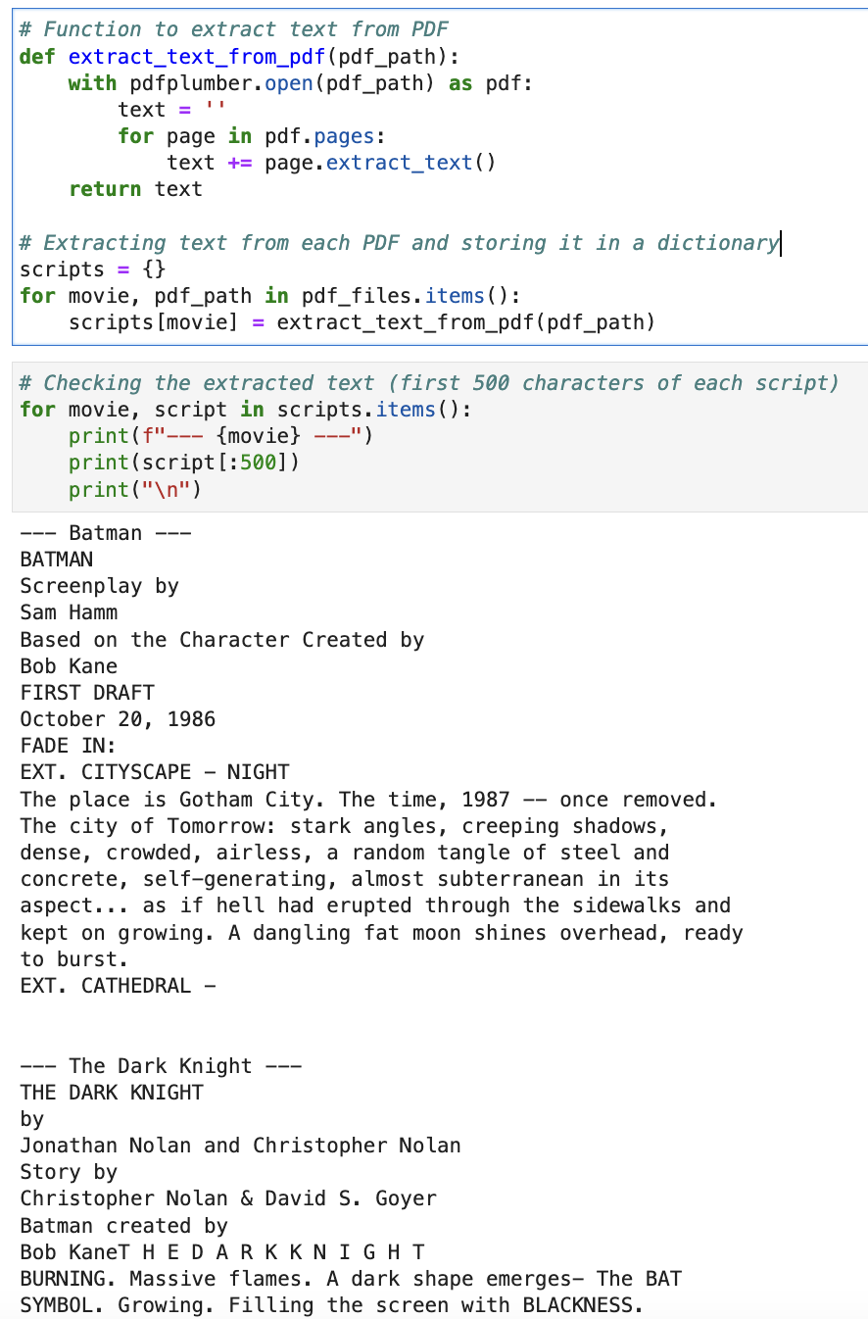
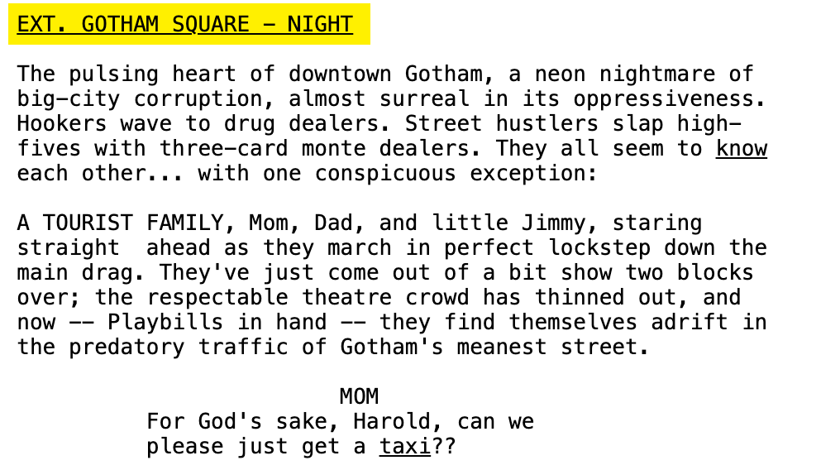
Data: Movie Scripts
Movie Scripts: PDFs for Batman (1986) and The Dark Knight (2008)
Libraries Used:
pdfplumber: To extract text from PDF files.
re: For regular expressions to clean and preprocess text.
nltk: For tokenizing and removing stopwords.
Steps:
Extract text from PDFs using pdfplumber.
Remove non-dialogue elements such as scene descriptions using regex patterns.
Tokenize text and remove stopwords for further analysis.

Slide 4
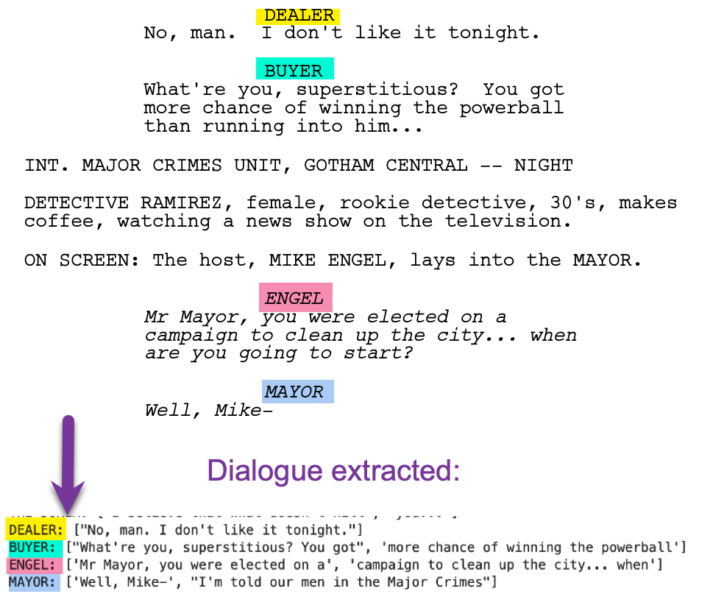
Batman Movie Scripts
Extracting Dialogue for Different Characters:
Used patterns to identify and remove scene descriptions (e.g., INT., EXT., FADE IN).
Identified character names by detecting uppercase lines with limited words.

Slide 5
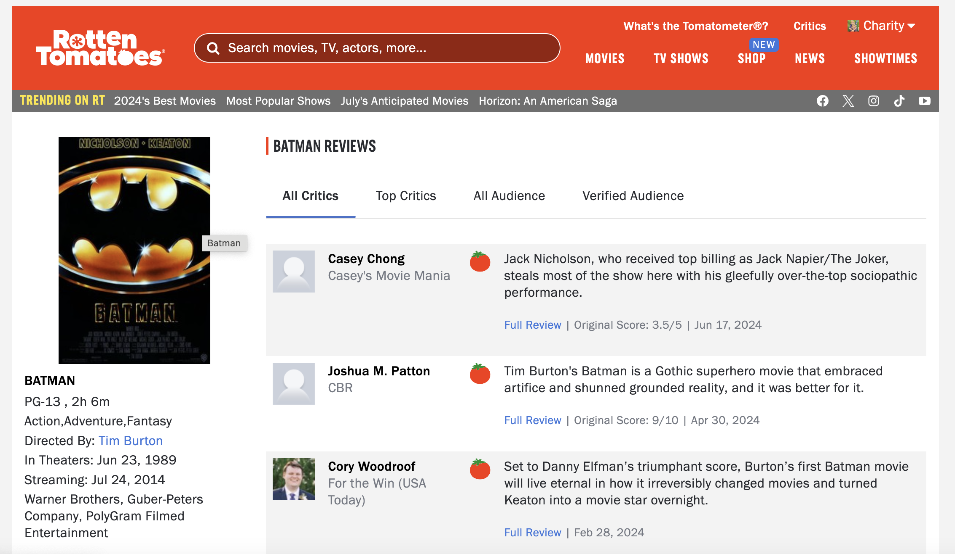
Data: Movie Reviews
Movie Reviews: Scraped from Rotten Tomatoes
Libraries Used:
selenium: For web scraping.
pandas: To store and manipulate the scraped reviews.
Steps:
Use selenium to automate the browser and scrape reviews from Rotten Tomatoes.
Click the "Load More" button to load all reviews.
Extract and store reviews in a pandas DataFrame.

Slide 6
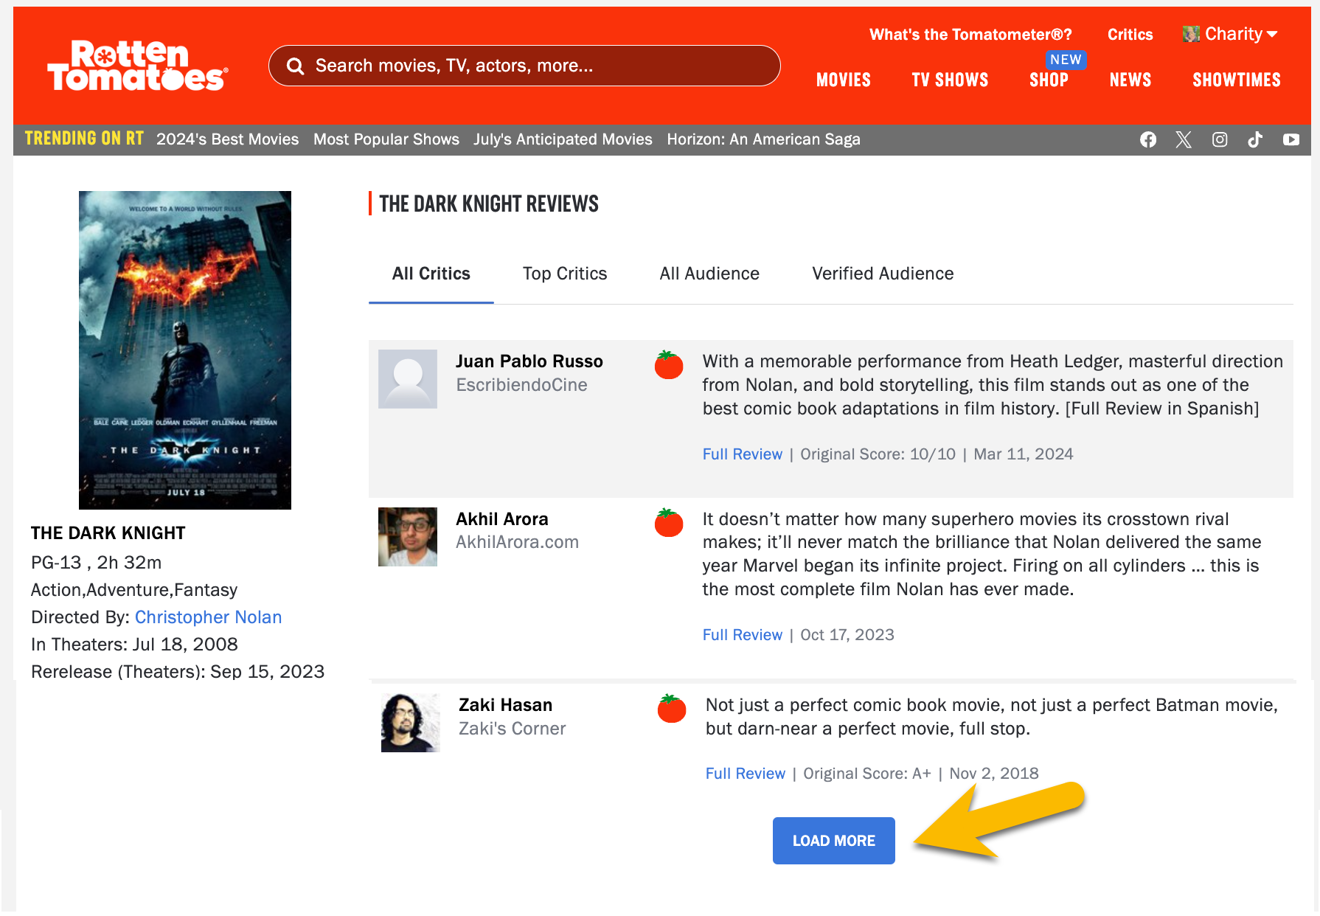
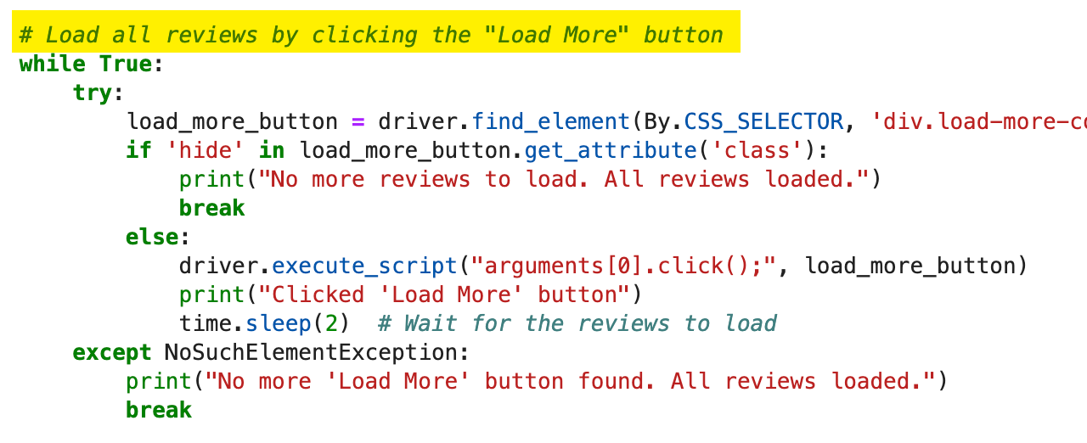
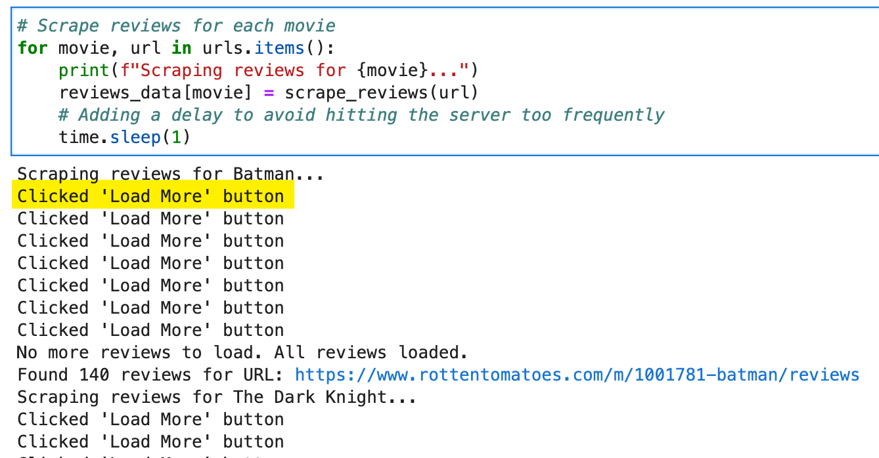
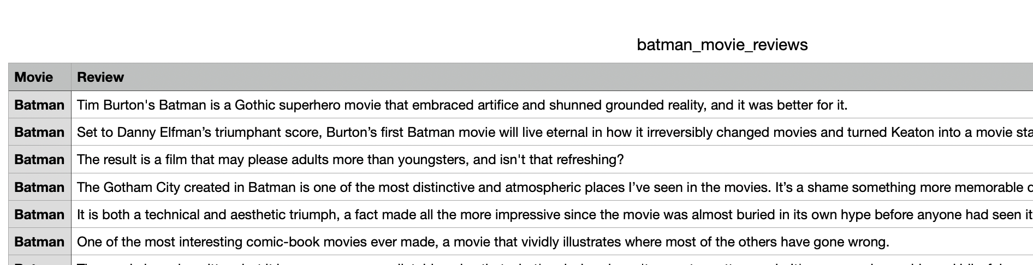
Batman Movie Reviews
Challenges with the "Load More" button:
The web pages required repeatedly clicking the "Load More" button to retrieve all reviews.
Implemented a loop to click the "Load More" button until all reviews were loaded.
Resulting CSV:
Scraped reviews were stored in a Pandas DataFrame and then saved as a CSV file.

Slide 7
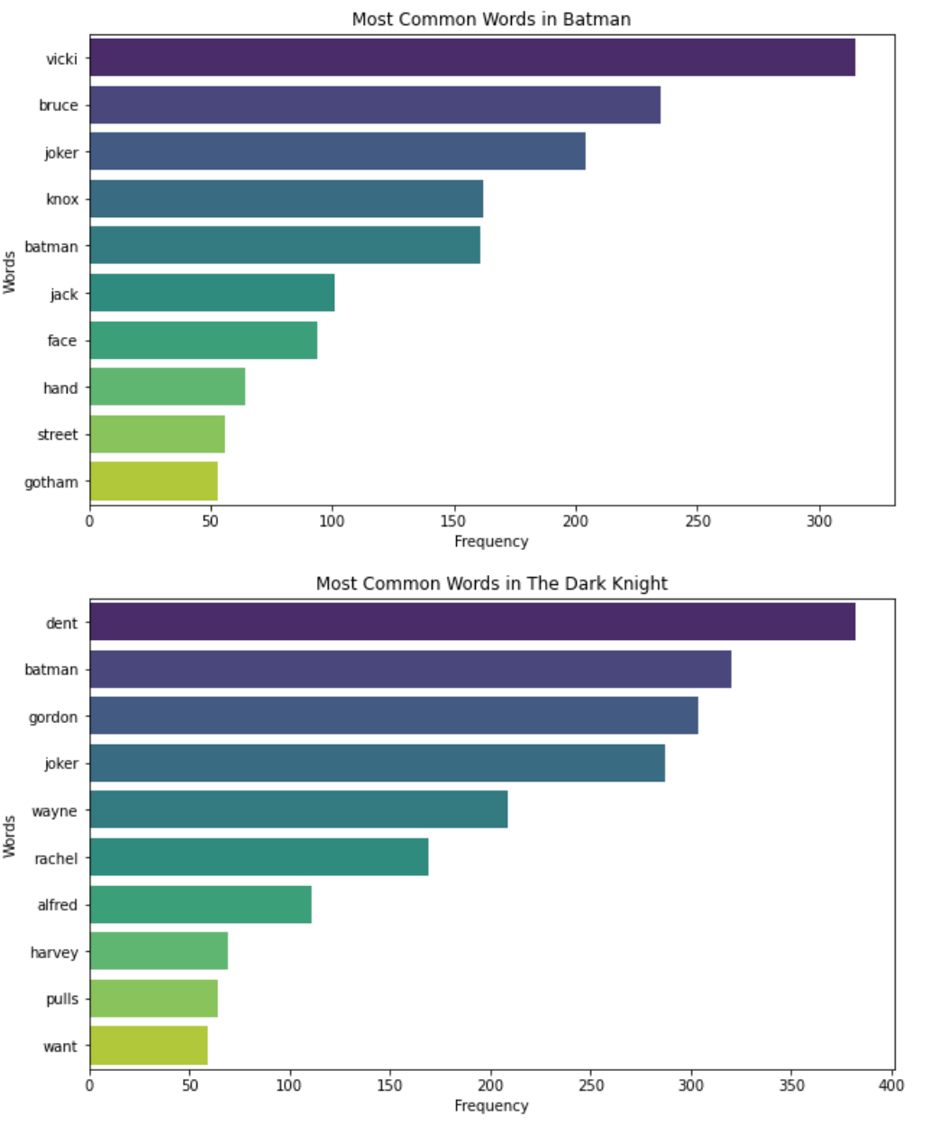
EDA in Movie Scripts
Most common adjectives:
Batman
Black, little, dead
The Dark Knight
Good, little, new
Number of Unique Characters in Each Movie:
Batman: 149, The Dark Knight: 143
Word Count
Batman
Mean: 7.60
Median: 8.0
Standard Deviation: 3.40
The Dark Knight
Mean: 6.83
Median: 7.0
Standard Deviation: 2.95
Average Word Length
Batman
Mean: 4.41
Median: 4.25
Standard Deviation: 1.15
The Dark Knight
Mean: 4.24
Median: 4.09
Standard Deviation: 1.10
Batman generally features longer words and dialogues with more variability in word count.
The Dark Knight has slightly more sentences per dialogue, with greater variability in sentence length.

Slide 8
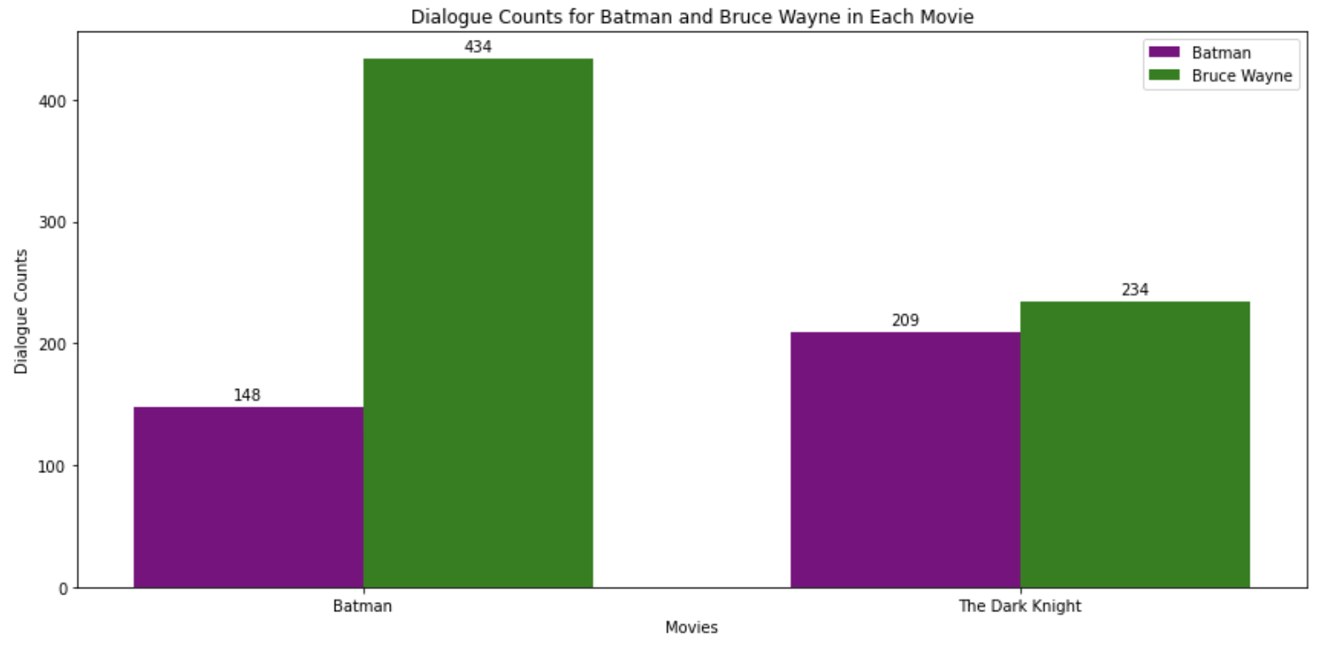
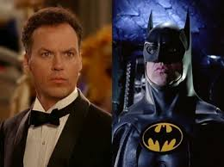
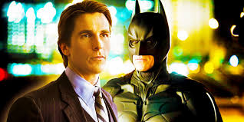
EDA in Movie Scripts – Batman or Bruce Wayne?

Slide 9
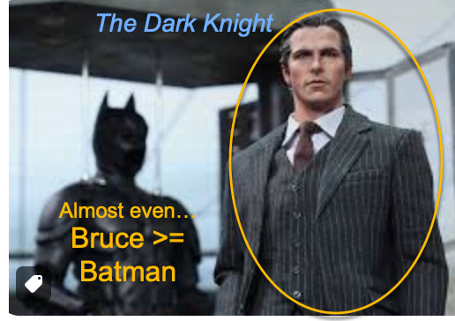
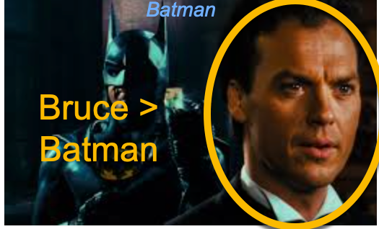
EDA in Movie Scripts – Batman or Bruce Wayne?

Slide 10
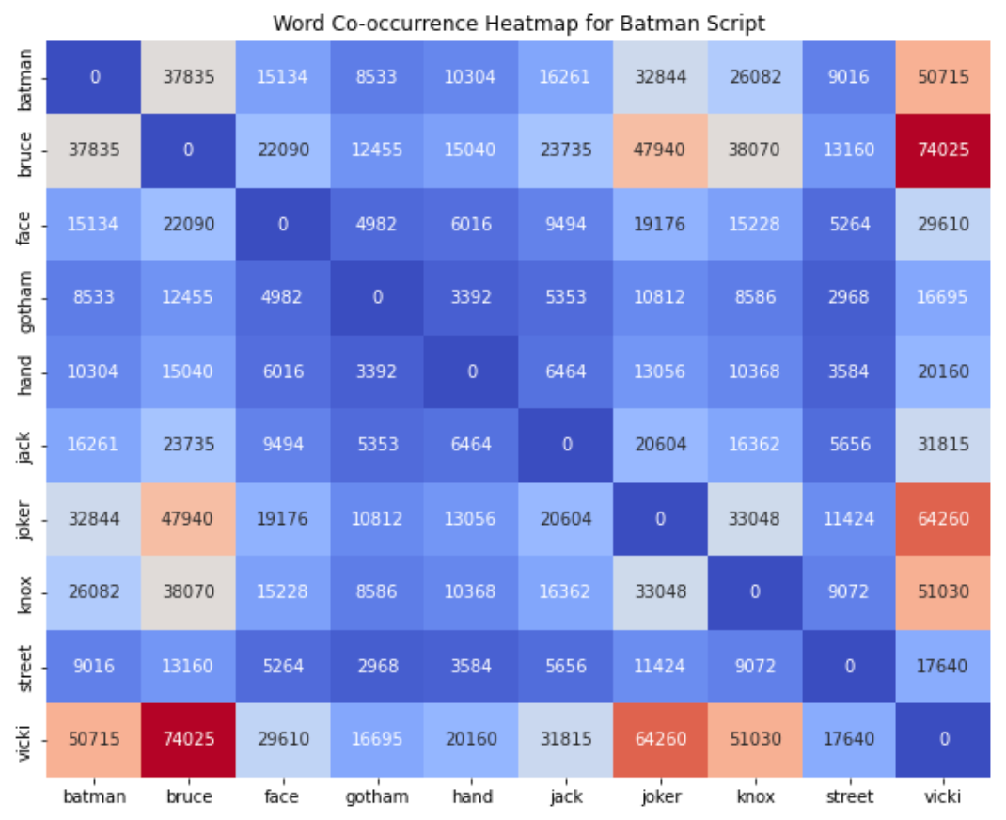
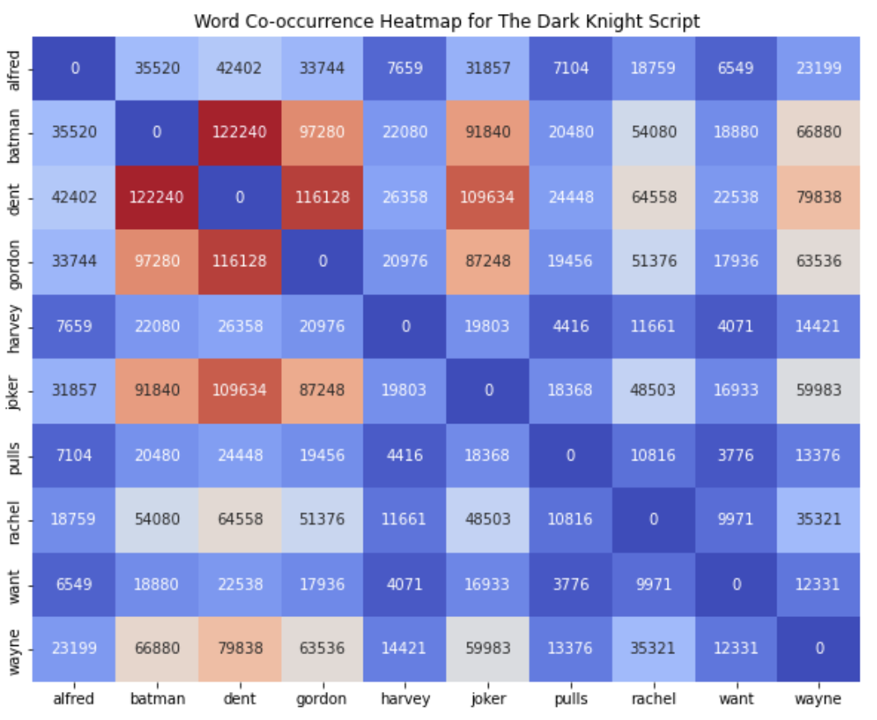
EDA in Movie Scripts – Word Co-occurrence Heatmaps
Characters like Bruce, Vicki, Dent, and Joker have strong interactions, as shown by the high co-occurrence frequencies.
The presence of frequent co-occurrences between key characters (e.g., Bruce and Vicki, Bruce and Joker) highlights pivotal relationships and interactions that drive the storyline.

Slide 11
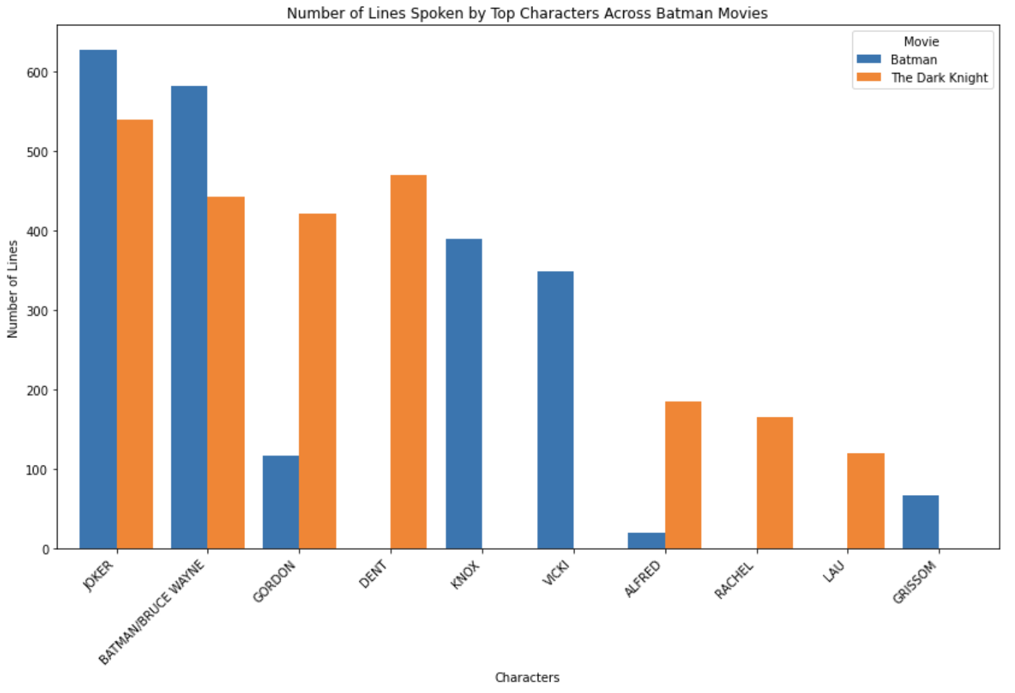
EDA in Movie Scripts – focusing on dialogue

Slide 12
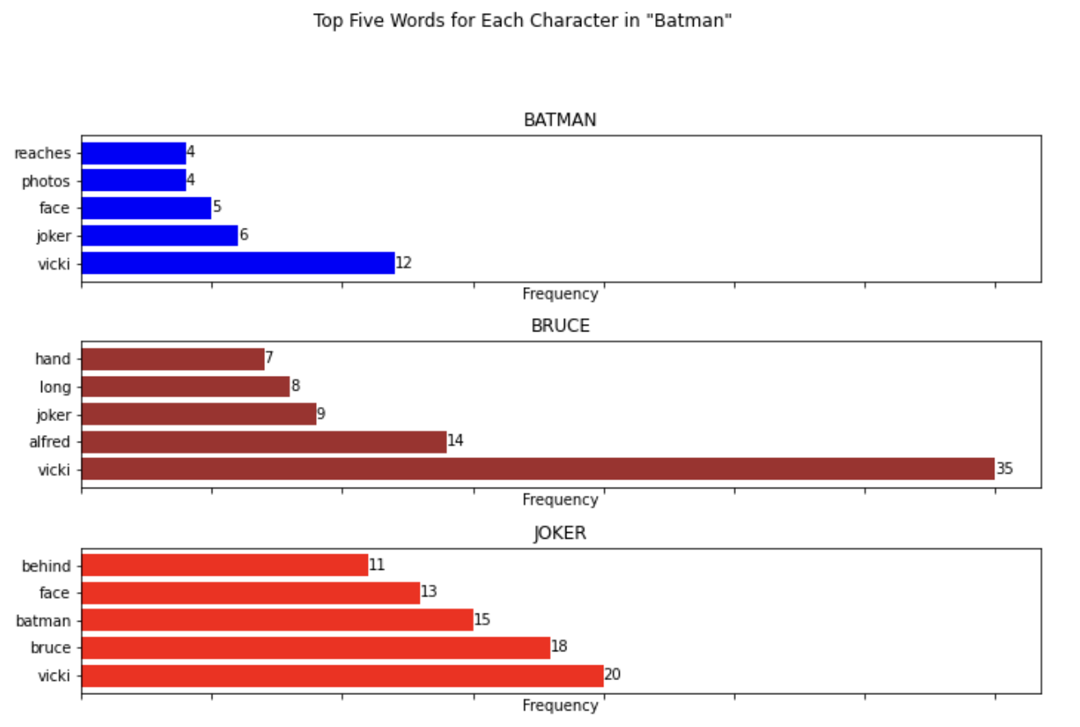
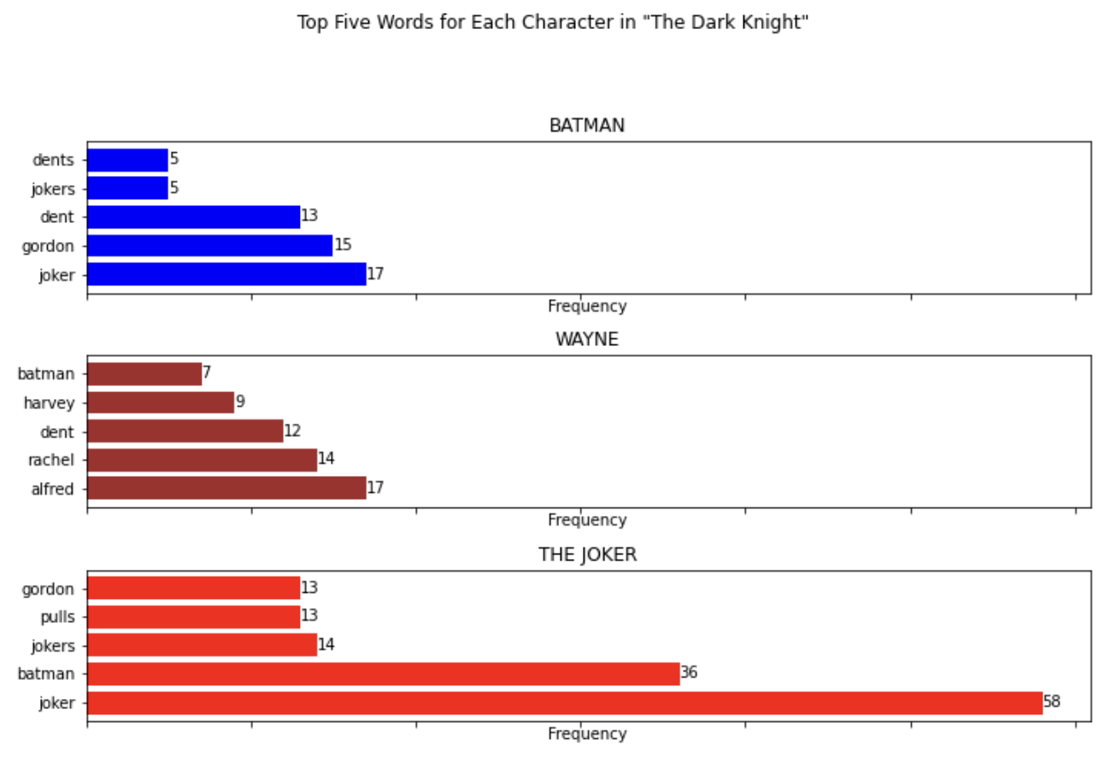
EDA in Movie Scripts – focusing on dialogue

Slide 13
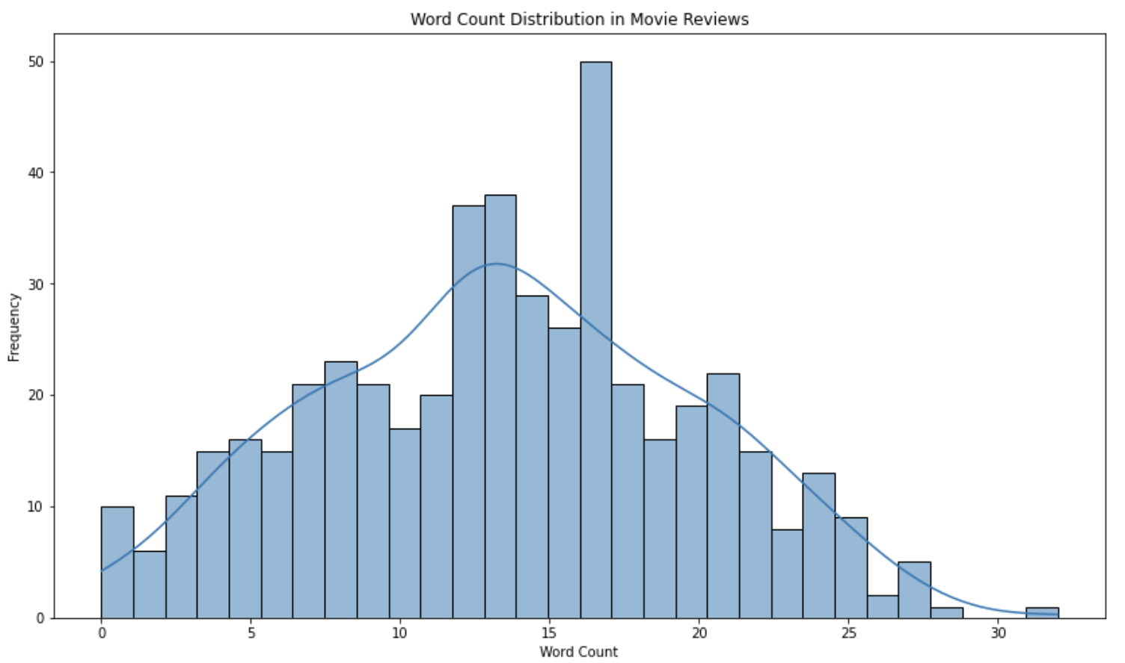
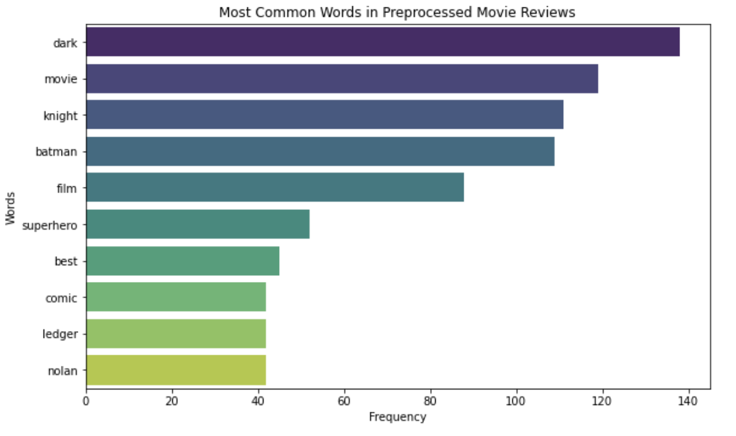
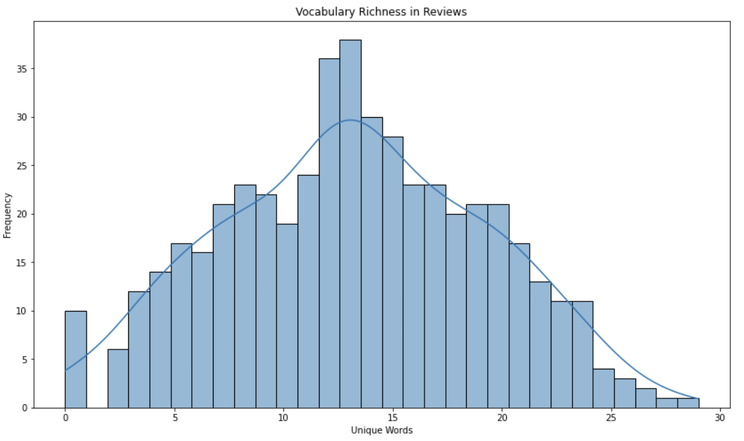
EDA in Movie Reviews
Most common adjectives:
Dark, best, good, great

Slide 14
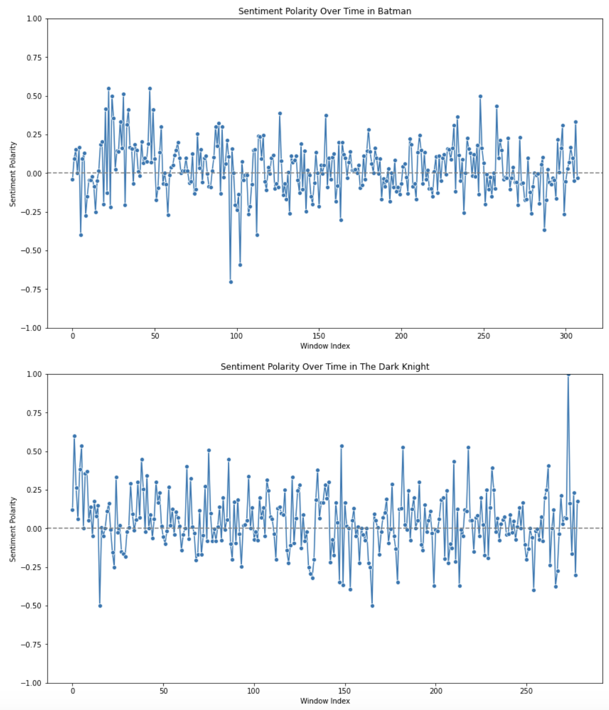
Sentiment Analysis in Movie Scripts
Methodology:
Using TextBlob for Sentiment Analysis:
TextBlob: A Python library for processing textual data, providing simple APIs NLP tasks.
Sentiment Analysis: The process of computationally identifying and categorizing opinions expressed in text to determine whether the writer's attitude towards a particular topic is positive, negative, or neutral.
Polarity and Subjectivity Scores for Preprocessed Text
Polarity Score: A float within the range [-1.0, 1.0], where -1.0 indicates a very negative sentiment, 0 indicates a neutral sentiment, and 1.0 indicates a very positive sentiment.
Subjectivity Score: A float within the range [0.0, 1.0], where 0.0 indicates very objective text and 1.0 indicates very subjective text.

Slide 15
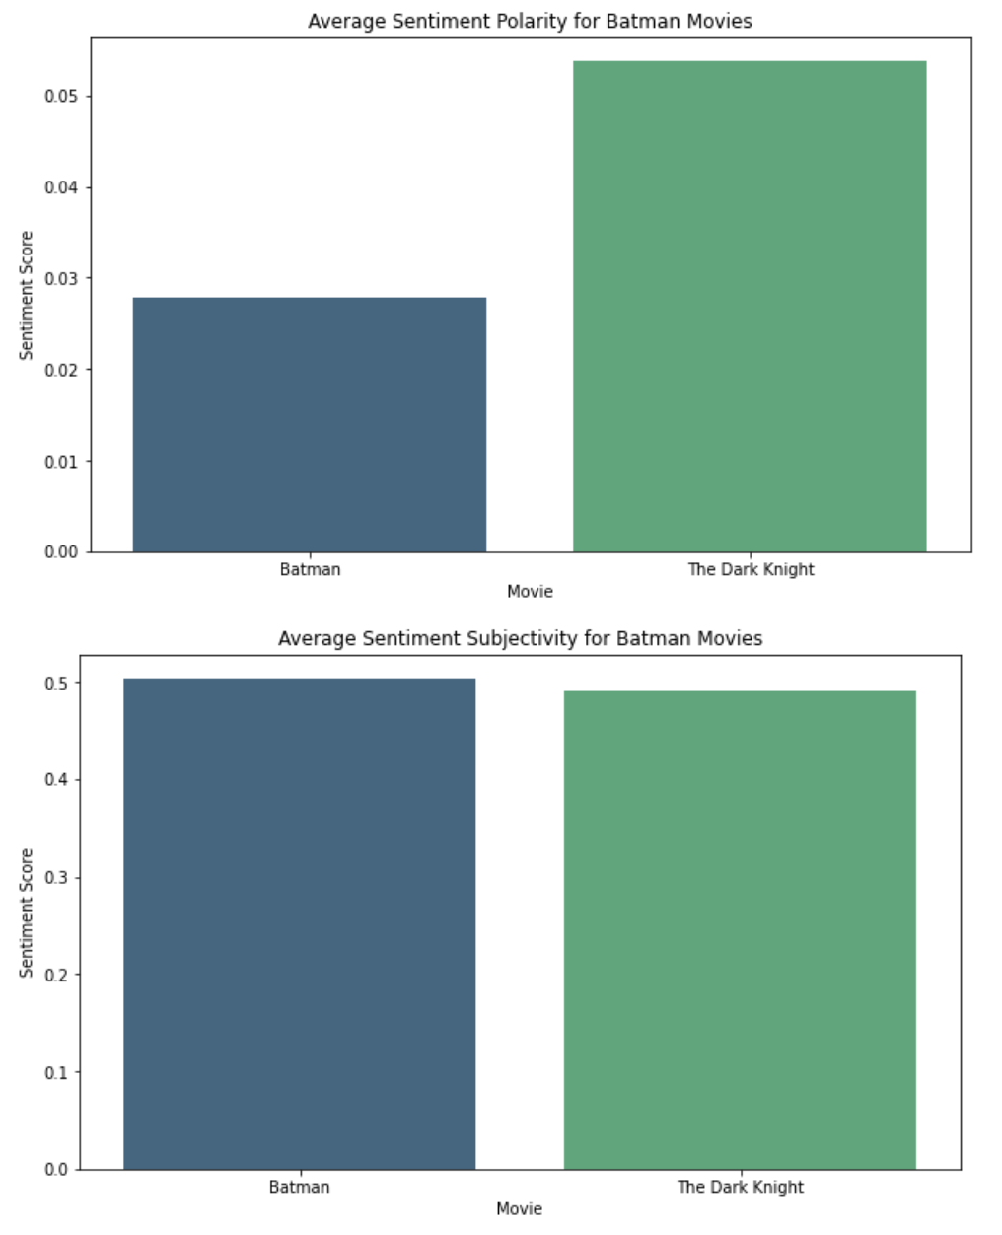
Sentiment Analysis in Movie Scripts
Results:
Batman
Polarity: 0.027875
Subjectivity: 0.503305
The Dark Knight
Polarity: 0.053719
Subjectivity: 0.491237
Summary:
Batman: Exhibits a slightly positive polarity and a moderately high subjectivity, indicating a balanced tone with some personal and opinionated elements.
The Dark Knight: Shows a more positive polarity and slightly lower subjectivity, indicating a more factual and objective tone but still with some positive sentiment.

Slide 16
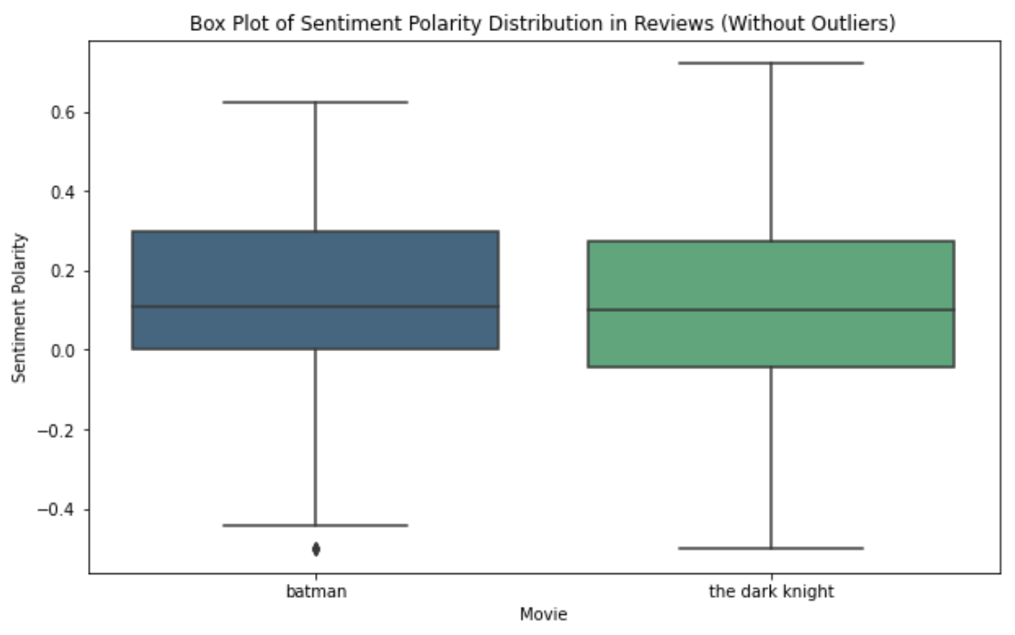
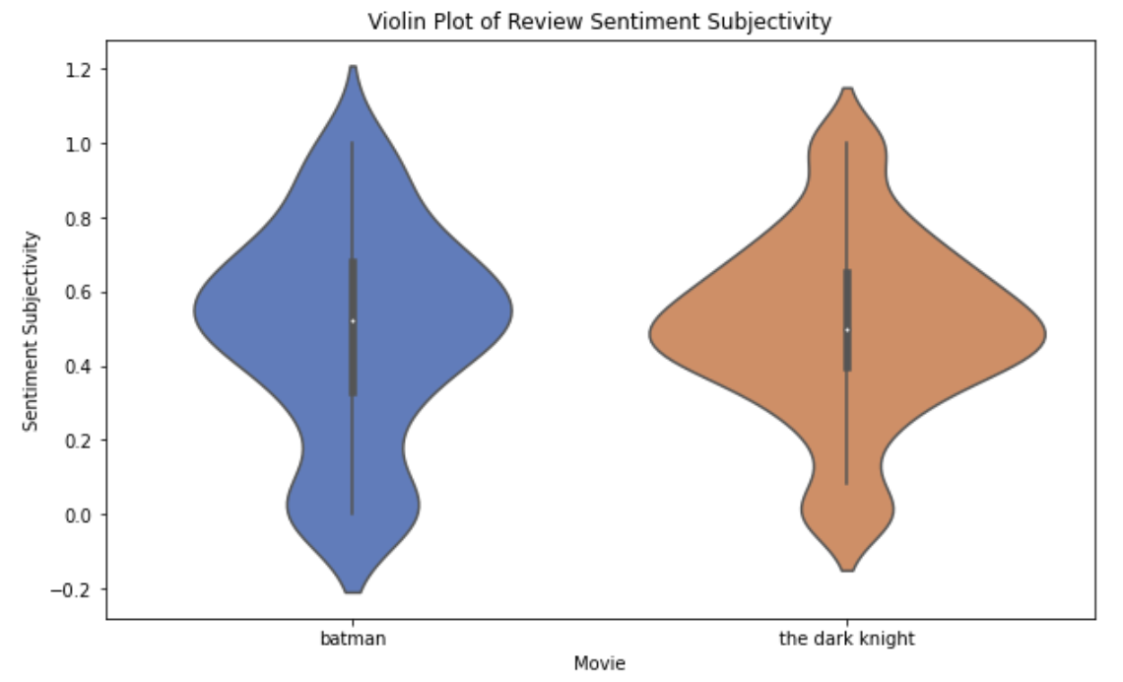
Sentiment Analysis in Movie Reviews
Sentiment polarity is a measure of the emotional tone expressed in text.
Box Plot: visual for the distribution of polarity scores.
Sentiment subjectivity measures how subjective or objective a text is.
Violin plot: visual for how subjective or objective the text is across different samples.

Slide 17
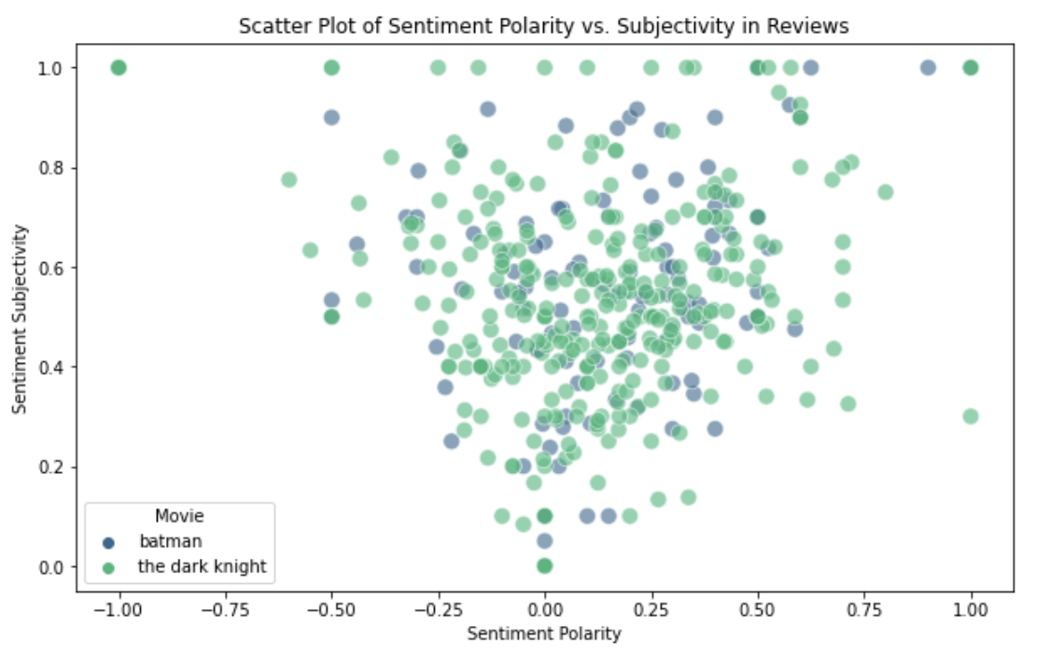
Sentiment Analysis in Movie Reviews
Results – Average Sentiment Scores:
Batman
Polarity: 0.132775, Subjectivity: 0.503305
The Dark Knight
Polarity: 0.108812, Subjectivity: 0.491237
Summary:
Batman
Polarity: Slightly higher positive sentiment.
Subjectivity: Slightly more subjective, indicating more personal and opinionated reviews.
The Dark Knight
Polarity: Slightly lower positive sentiment.
Subjectivity: Slightly more objective, indicating more factual reviews.

Slide 18
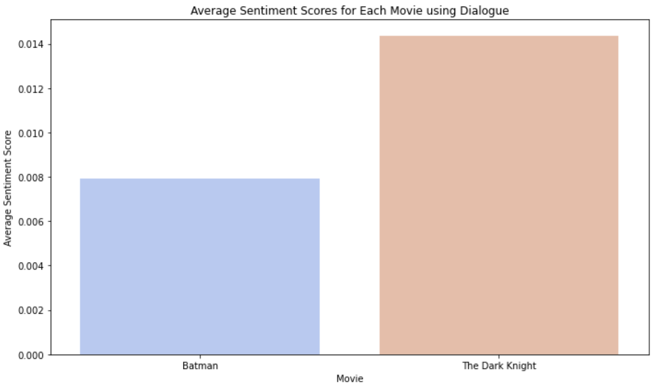
Sentiment Analysis in Dialogue
TextBlob and VADER Sentiment Analysis:
TextBlob: Provides polarity and subjectivity scores for dialogues. Uses a predefined dictionary of words associated with positive and negative sentiments.
VADER (Valence Aware Dictionary and sEntiment Reasoner): A lexicon and rule-based sentiment analysis tool specifically attuned to sentiments expressed in social media and informal text. Provides detailed sentiment scores including positive, neutral, negative, and compound scores.
Comparison of Sentiment Scores for Characters:
Analyzed sentiment for key characters in Batman and The Dark Knight using both TextBlob and VADER.
Compared the results to understand differences in sentiment perception.

Slide 19
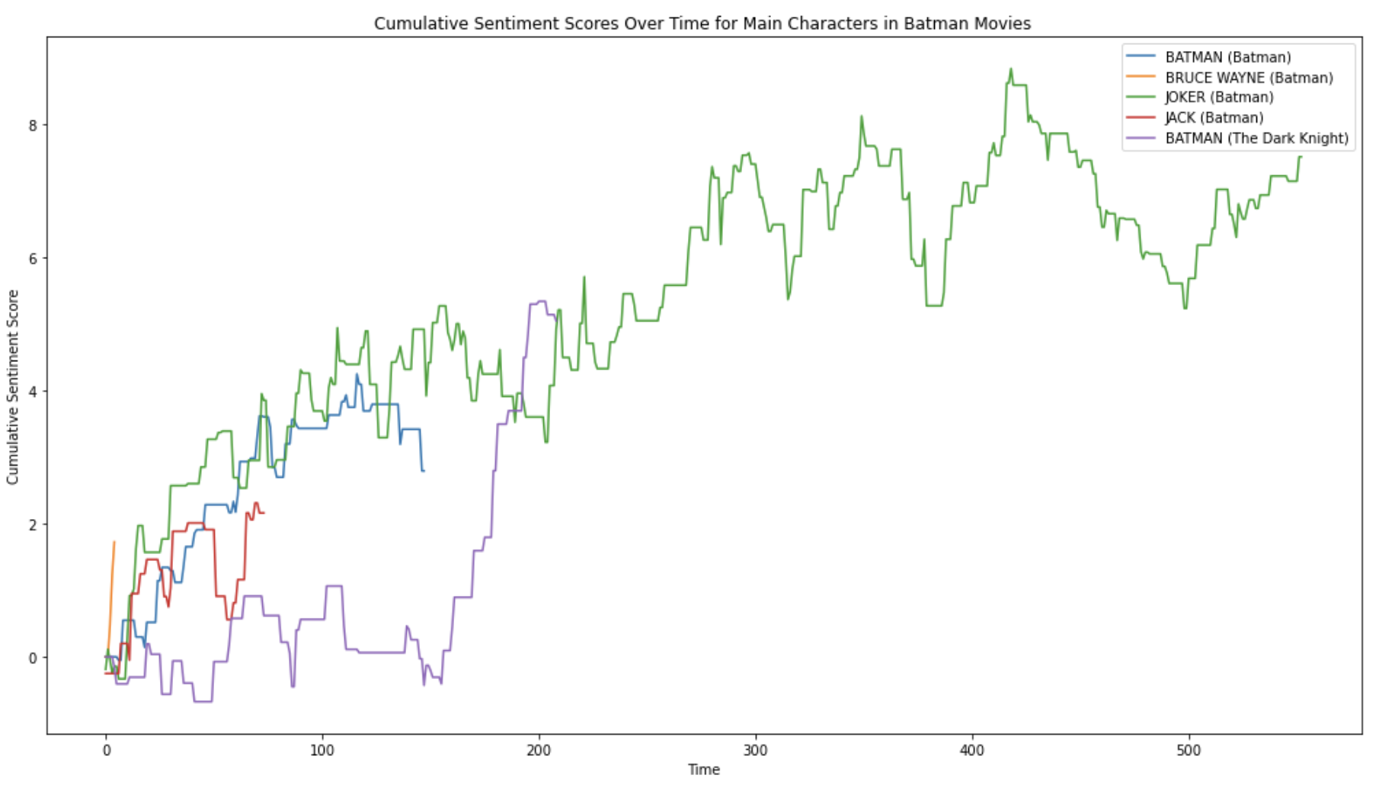
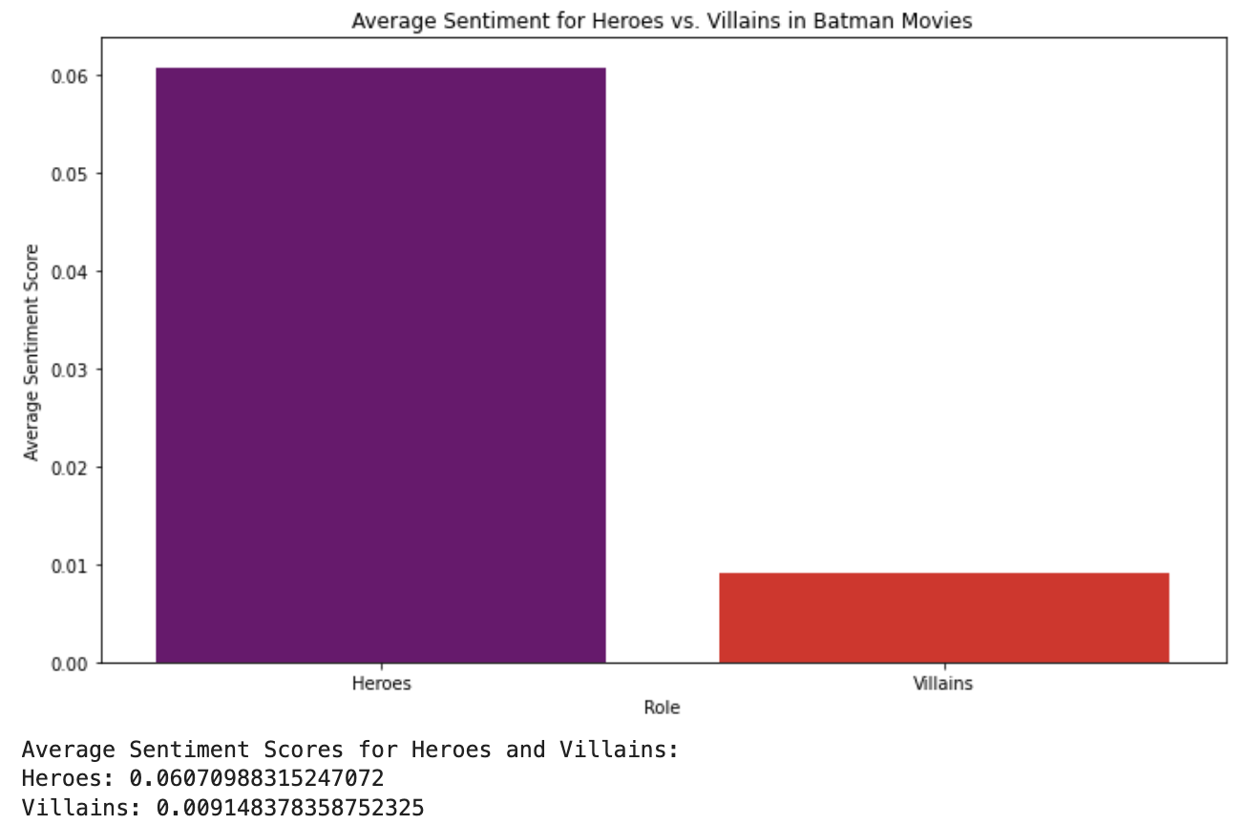
Sentiment Analysis in Dialogue - Results

Slide 20
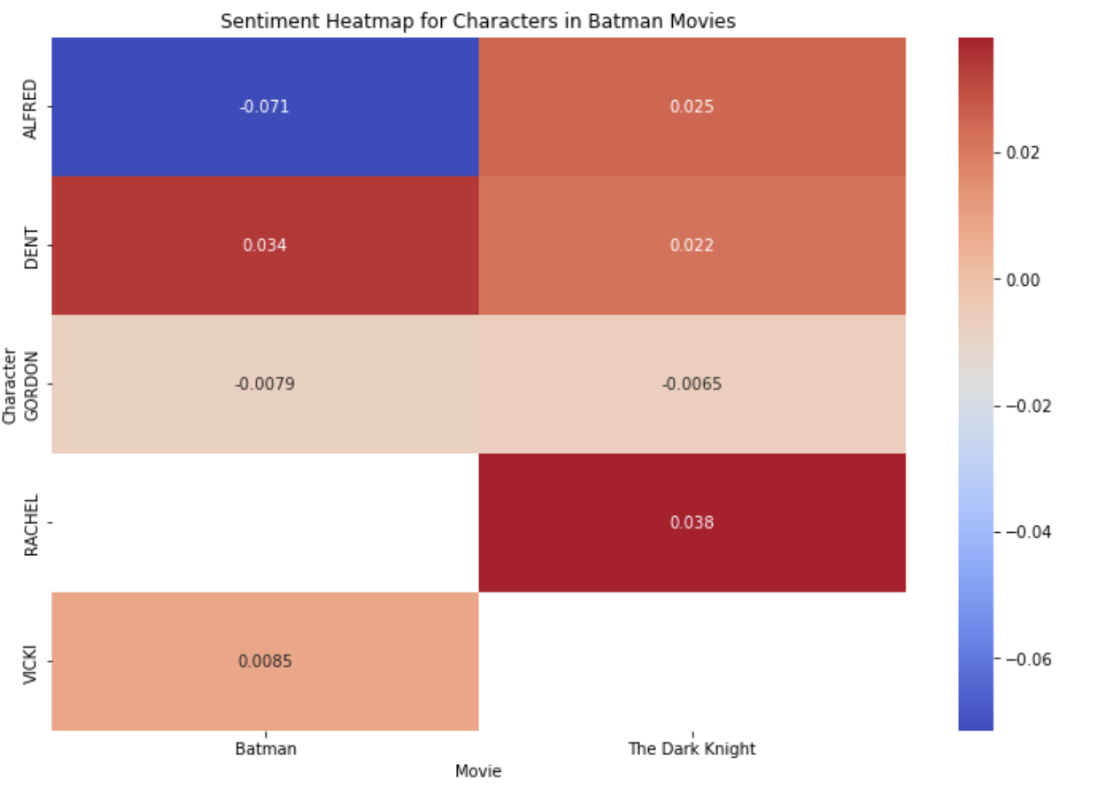
Sentiment Analysis with Supporting Characters
Characters in The Dark Knight generally have more positive sentiment scores compared to those in Batman.
Alfred's sentiment is negative in Batman and positive in The Dark Knight.
Rachel in The Dark Knight has the highest positive sentiment score, indicating a very favorable sentiment in her dialogues.

Slide 21
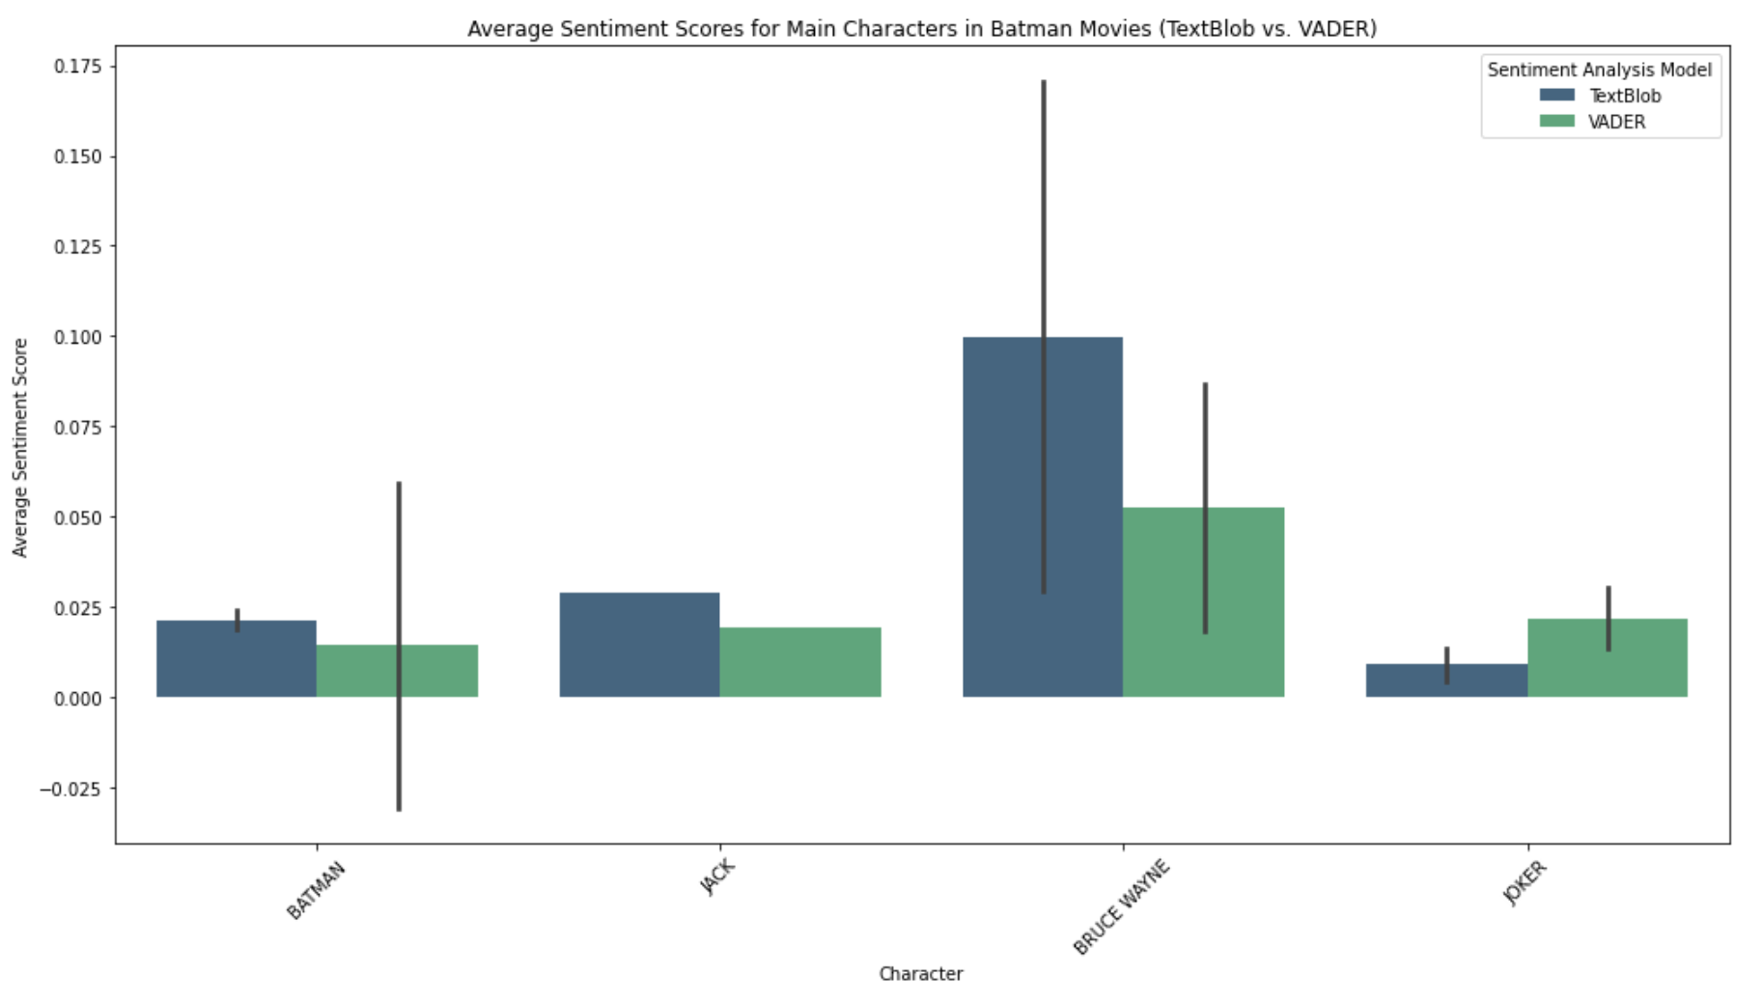
Sentiment Analysis in Dialogue - Results
TextBlob Sentiment Scores for Main Characters:
Batman
BATMAN: 0.0189, JACK: 0.0292, BRUCE WAYNE: 0.1703, JOKER: 0.0136
The Dark Knight
JOKER: 0.0047, BATMAN: 0.0241, BRUCE WAYNE: 0.0295
VADER Sentiment Scores for Main Characters:
Batman
BATMAN: 0.0593, JACK: 0.0196, BRUCE WAYNE: 0.0868, JOKER: 0.0307
The Dark Knight
JOKER: 0.0134, BATMAN: -0.0303, BRUCE WAYNE: 0.0184

Slide 22
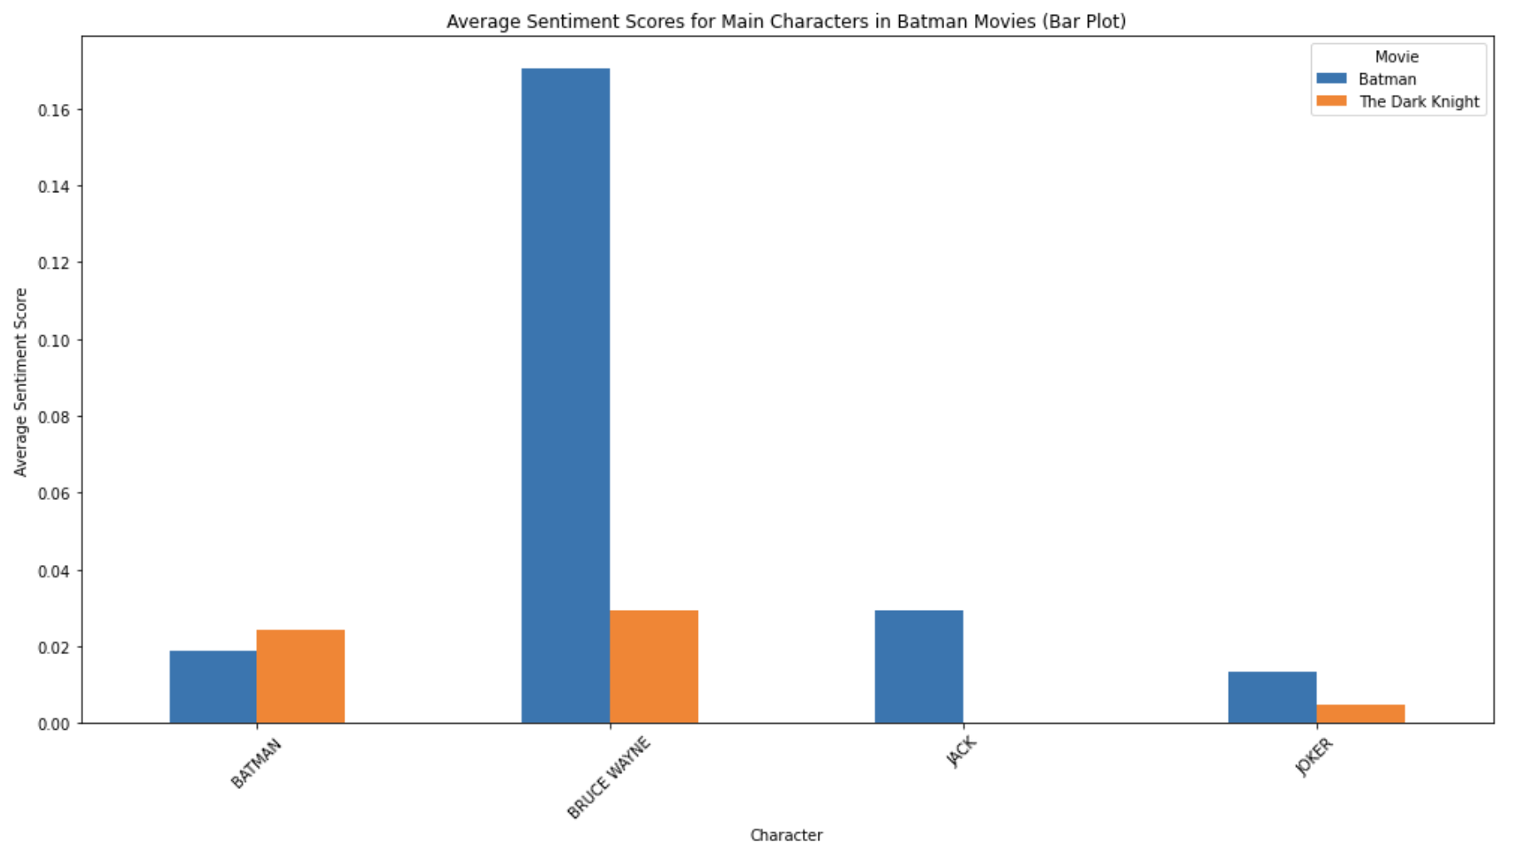
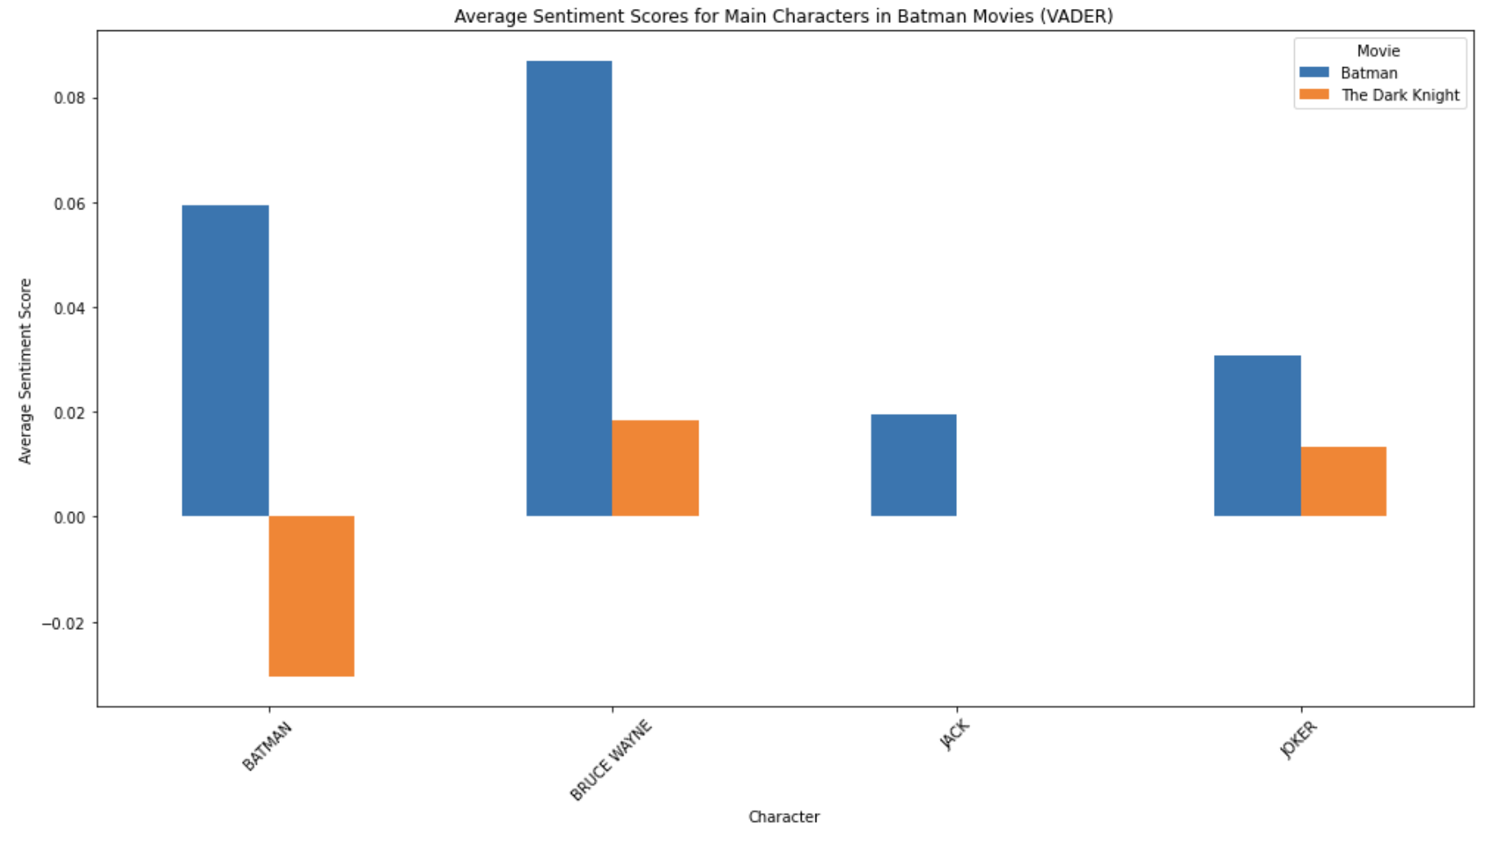
TextBlob
Bruce Wayne in Batman has the highest positive sentiment score (0.1703), indicating a more positive tone in his dialogues
The Joker has neutral sentiment scores in both movies, with slightly positive scores but generally close to neutral.
Batman has neutral to slightly positive sentiment scores in both movies, indicating a balanced tone in his dialogues.
VADER:
Bruce Wayne in Batman with a positive sentiment score (0.0868), but lower than TextBlob's score.
The Joker has neutral sentiment scores in both movies
Batman has a slightly negative sentiment score (-0.0303) in The Dark Knight" contrasting with TextBlob's slightly positive score.

Slide 23
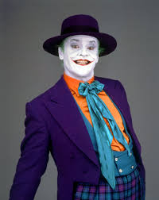
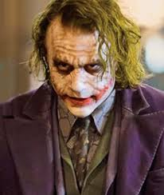
The Joker is… neutral?
”Let's put a smile on that face!"
The Joker's dialogues, as analyzed through TextBlob and VADER, show a neutral or slightly positive sentiment score… but how?
The Joker is widely recognized as a dark and malevolent villain!
Complexity of Language: The Joker often uses complex and nuanced language that can mask the underlying dark intent. His dialogues are laced with sarcasm, irony, and a playful tone that may be interpreted by sentiment analysis models as neutral or slightly positive.
Context and Delivery: The emotional impact of the Joker's words is heavily influenced by the context in which they are delivered and his performance, including tone, facial expressions, and body language. These aspects are not captured by text-based sentiment analysis models.
Dark Humor: The Joker's dialogues often contain dark humor, which can be perceived as humorous or playful. This can skew the sentiment analysis towards neutral or positive, even though the content is dark and disturbing.
Given these factors, the neutral or slightly positive sentiment scores for the Joker's dialogues can be understood as a limitation of the sentiment analysis models in capturing the full context and nuance of his speech.
“Why so serious?”

Slide 24
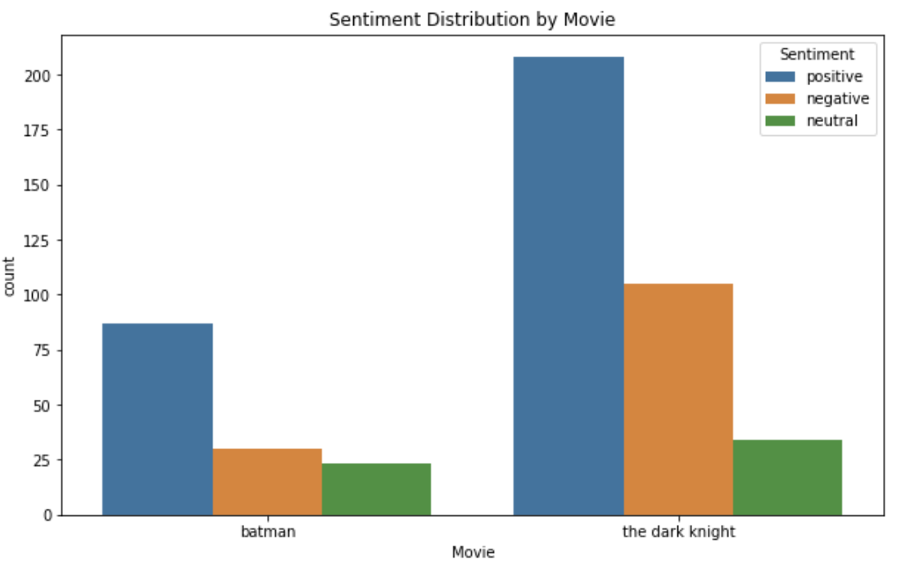
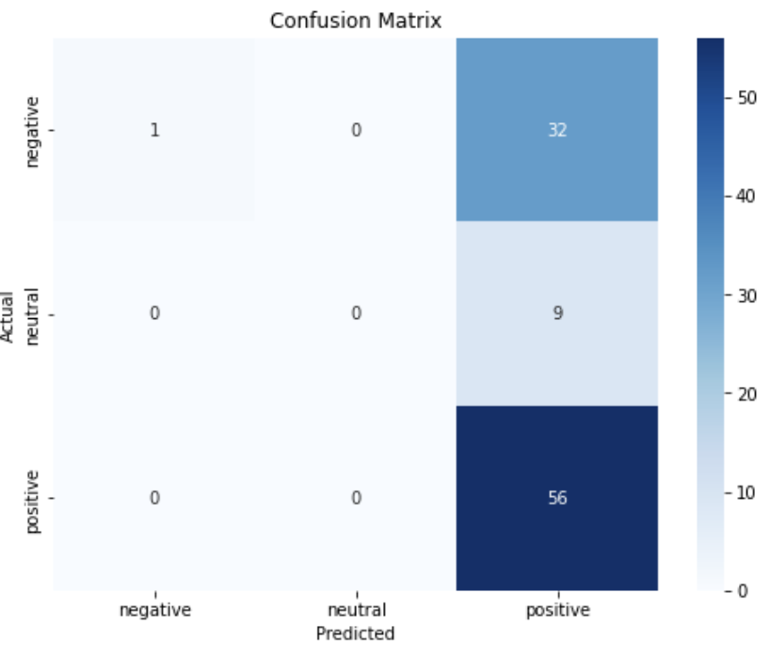
The Reviews say… which movie is the best?
Machine Learning and Sentiment Polarity
Initial Sentiment Polarity Analysis
Initial Model Performance
Batman: Average sentiment polarity of 0.132296, suggesting generally positive reviews.
The Dark Knight: Average sentiment polarity of 0.108523, also suggesting positive reviews, but slightly less favorable.
Accuracy: 58.16%
Confusion Matrix:
Negative: 1 correctly predicted, 32 misclassified as positive.
Neutral: None correctly predicted, all misclassified as positive.
Positive: All correctly predicted.
Using Naive Bayes Classifier:
Classified reviews into positive, negative, and neutral sentiments based on polarity scores.
Sentiment Polarity Analysis Based on Reviews:
Calculated the average sentiment polarity for each movie to determine the overall sentiment expressed in the reviews.
Compared sentiment polarity between Batman and The Dark Knight.

Slide 25
The Reviews say… which movie is the best?
Machine Learning and Sentiment Polarity
Initial Sentiment Polarity Analysis
Initial Model Performance
Initial Model Performance: 58.16%
High accuracy for positive class.
Poor performance for negative and neutral classes.
Bias towards positive class due to higher support (56 out of 98 reviews).
Struggles to differentiate negative and neutral sentiments from positive ones.
Class Imbalance:
Many more positive reviews than negative or neutral ones.
Techniques like resampling or class weighting needed to improve model performance.
Batman: Average sentiment polarity of 0.132296, suggesting generally positive reviews.
The Dark Knight: Average sentiment polarity of 0.108523, also suggesting positive reviews, but slightly less favorable.
Accuracy: 58.16%
Confusion Matrix:
Negative: 1 correctly predicted, 32 misclassified as positive.
Neutral: None correctly predicted, all misclassified as positive.
Positive: All correctly predicted.
Using Naive Bayes Classifier:
Classified reviews into positive, negative, and neutral sentiments based on polarity scores.
Sentiment Polarity Analysis Based on Reviews:
Calculated the average sentiment polarity for each movie to determine the overall sentiment expressed in the reviews.
Compared sentiment polarity between Batman and The Dark Knight.

Slide 26
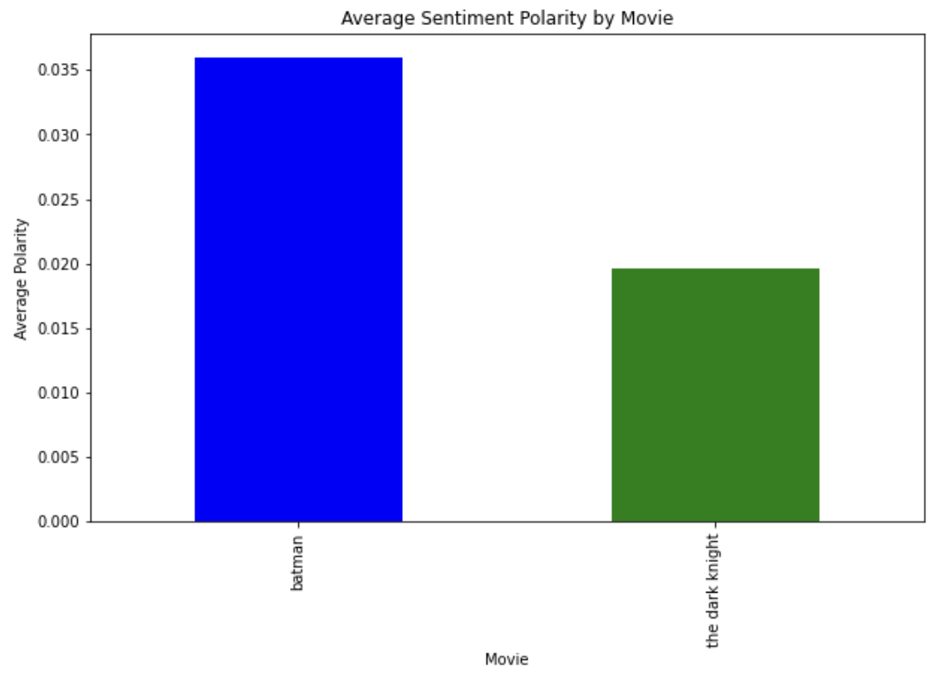
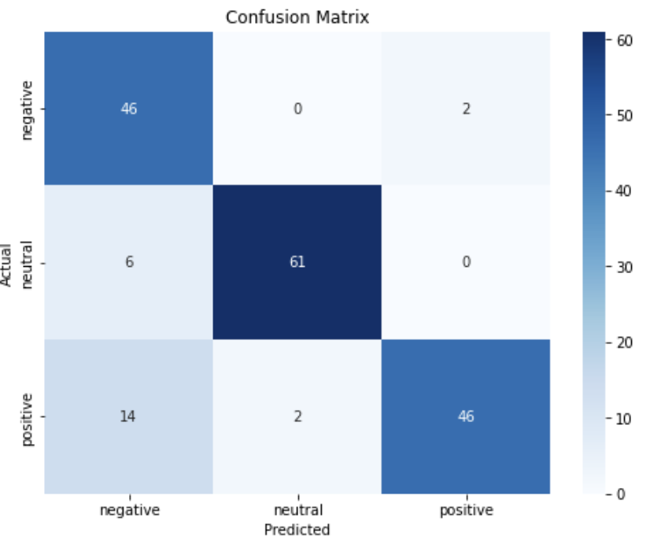
The Reviews say… which movie is the best?
Improved Machine Learning Approach
Best Movie Based on Overall Review Sentiment Analysis
Improved Model Performance
Batman with a slightly higher average sentiment polarity.
Accuracy: 86.44%
Confusion Matrix:
Negative: 46 correctly predicted, 2 misclassified as positive.
Neutral: 61 correctly predicted, 6 misclassified as negative.
Positive: 46 correctly predicted, 14 misclassified as negative.
Addressing Class Imbalance: Resampled minority classes (negative and neutral) to balance the dataset.
The improved model significantly outperforms the initial model.
Addressing class imbalance through resampling greatly enhances model performance.

Slide 27
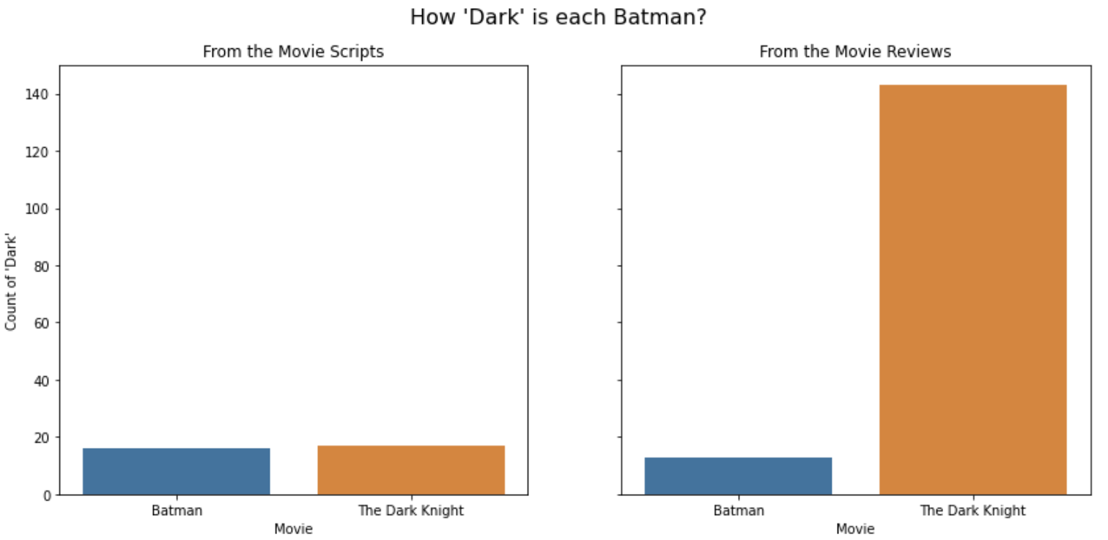
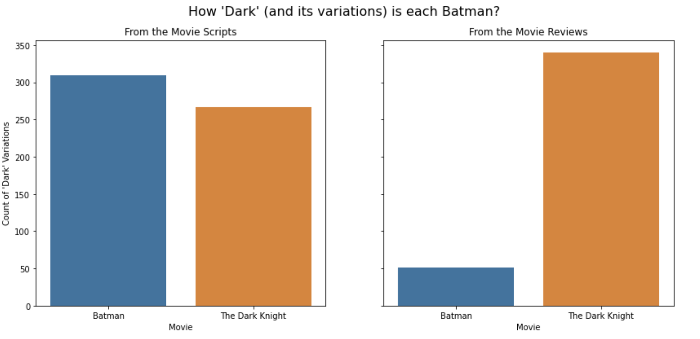
Let’s get literal… Which Movie is the "Darkest"?
Method
Counting occurrences of the word "dark" and its variations in movie scripts and reviews.
Included a second analysis with terms like gloomy, shadow, grim, sinister, eerie, etc.
Conclusion
The Dark Knight is the darkest movie based on the number of dark-related terms in reviews.
Batman shows a higher count of dark variations in scripts.
Notes:
Scripts
{'Batman': 16, 'The Dark Knight': 17}
{'Batman': 310, 'The Dark Knight': 267}
Reviews
{'Batman': 13, 'The Dark Knight': 143}
{'Batman': 51, 'The Dark Knight': 340}

Slide 28
Conclusions
Best Movie Based on Overall Review Sentiment Analysis:
Batman - slightly higher average sentiment polarity.
Darkest Movie Based on Sentiment Polarity in Reviews:
The Dark Knight - higher occurrences of dark-related terms in reviews.
Darkest Movie Based on Script Analysis:
Batman - higher count of dark variations in scripts.
Most Subjective Movie Based on Sentiment in Reviews:
The Dark Knight - higher subjectivity scores indicating more personal and opinionated reviews.
Most Subjective Movie Based on Sentiment in Scripts:
Batman - higher subjectivity scores indicating more personal and opinionated dialogues.

Slide 30
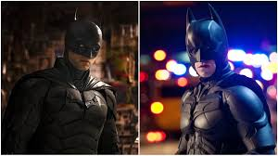
Final Recommendation
Popularity:
Draw inspiration from Batman to maintain broad appeal.
Character Complexity and Darkness:
Emphasize elements from The Dark Knight for a darker tone and more intricate character dynamics.
Balance!
Combine the strengths of both movies to create a balanced and compelling portrayal in future Batman productions.

Slide 31
Future Steps and Improvements
Explore Character Interactions: Create conversation maps to visualize character dynamics and interactions. Analyze dialogue to understand the flow and intensity of character relationships.
Evaluate Sentiment Analysis: Improve sentiment analysis models to better detect sarcasm and tone. Address the neutral sentiment results of characters like The Joker, which may be due to sarcasm and jokes.
Custom Sentiment Lexicon: Develop and use a custom sentiment lexicon tailored to the unique language and tone of Batman movies. Train and evaluate models using this custom lexicon to improve accuracy.
Character-Specific Sentiment Analysis: Perform sentiment analysis on a per-character basis to capture individual character tones and emotions. Compare and contrast sentiment dynamics between different characters.
Temporal Analysis: Conduct temporal analysis of sentiment to observe how character emotions and interactions evolve over the course of the movie.
Additional Movie Analysis: Extend the analysis to include additional Batman movies for comparative insights on character development and narrative style.

Slide 32
CREDITS
Thomas, E., Nolan, C., & Goyer, D. (2009). The dark knight directed by Christopher Nolan. France; Warner Brothers.
Peters, J., Guber, P., & Hamm, S. (1989). Batman. United States; Warner Bros.
Presentation Template: SlidesMania

